Slide 1
Intermediate Hibernate Framework
Course
Java programming
Trainer
Designed by
To Chau
Last updated
Jul 25, 2011

Slide 2
Objectives
This course provides attendees a deeply knowledge of Hibernate techniques and share some tips or experiences.

Slide 3
Contents
Advance Hibernate mapping
References
Q&A

Slide 4
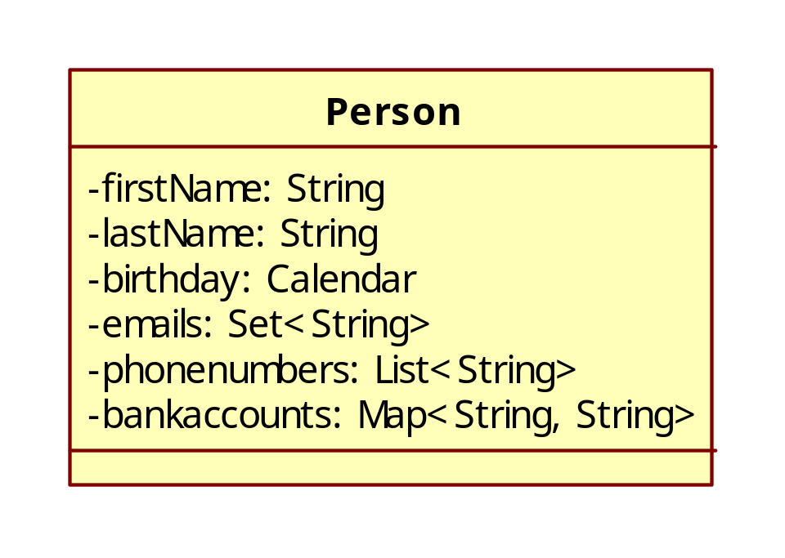
Mapping collection

Slide 5
Mapping element - Set
<set name="emails" table="EMAILS" inverse="false“ lazy="true"> <key> <column name="PERSONID" /> </key> <element type="java.lang.String"> <column name="EMAIL" /> </element> </set>

Slide 6
Mapping element - List
<list name="phonenumber" inverse="false" table="PHONENUMBERS" lazy="true"> <key> <column name="PERSONID" /> </key> <list-index base="1" column="POSITION" ></list-index> <element type="java.lang.String"> <column name="PHONENUMBER" /> </element> </list>

Slide 7
Mapping element - Map
<map name="bankAccounts" table="BANKACCOUNTS" lazy="true"> <key> <column name="PERSONID" /> </key> <map-key type="java.lang.String"> <column name="ACCOUNTNUMBER"></column> </map-key> <element type="java.lang.String"> <column name="BANK" /> </element> </map>

Slide 8
Exercise:

Slide 9
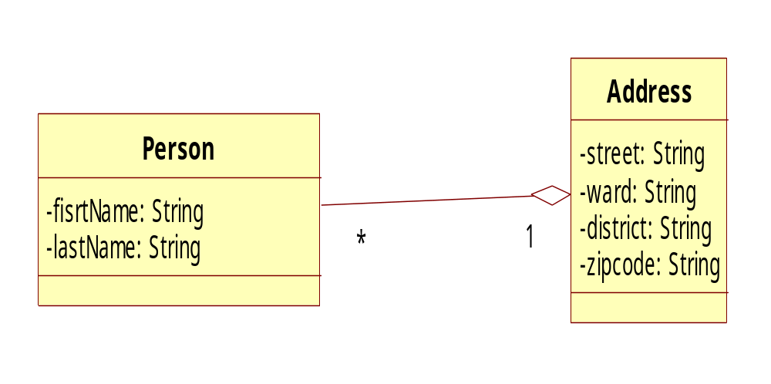
Many-to-one

Slide 10
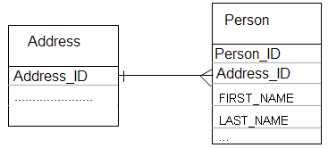
One-to-many
Table schema:

Slide 11
One-to-many
Hibernate mapping: Address mapping
<hibernate-mapping> <class name=“Address" table=“ADDRESS"> <id name="id" column=“ADDRESS_ID" type="long" unsaved-value="0"> <generator class="hilo"/> </id> <property name="name" column=“ CITY" type="string" length="15" not-null="true"/> <set name=“people" cascade="all" inverse="true" lazy="true"> <key column="address_id"/> <one-to-many class=“person"/> </set> … </class> </hibernate-mapping>
Scenario: Set<Person> people = team.getPeople();
// Return a collection of Player instances

Slide 12
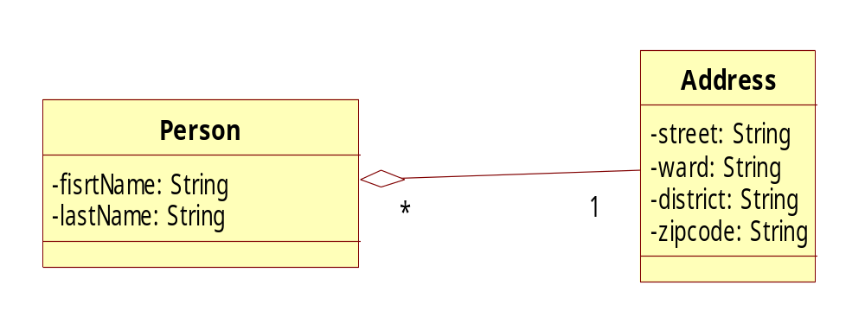
One-to-many

Slide 13
Many-to-one
Table schema:

Slide 14
Many-to-one
Hibernate mapping: Person mapping
<hibernate-mapping> <class name=“Person" table=“PERSON"> <id name="id" column=“PLAYER_ID" type="long" unsaved-value="null"> <generator class="hilo"/> </id> <property name="firstName" column=“FIRST_NAME" type="string" length="12" not-null="true"/> <property name="lastName" column=“LAST_NAME" type="string" length="15" not-null="true"/> … <many-to-one name="address" class=“Address" column=“address_id"/> </class> </hibernate-mapping>
Scenario: Address address = person.getAddress();
// Return corresponding Team instance

Slide 15
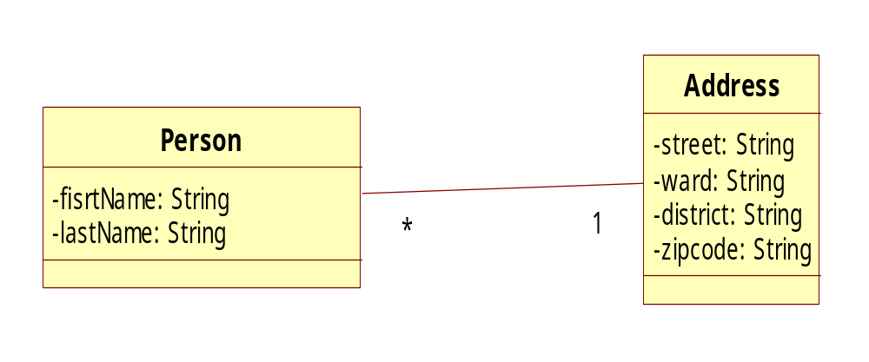
Exercise:

Slide 16

Exercise:

Slide 17

Many-to-many

Slide 18
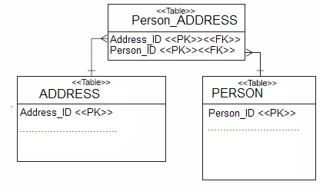
Many-to-many
Table schema:

Slide 19
Many-to-many
Hibernate mapping: Person mapping
<hibernate-mapping> <class name=“Person" table=“PERSON"> ... <set name=“addresses" table=“ADDRESS_PERSON" lazy="true" inverse="true" cascade="save-update"> <key column=“PERSON_ID"/> <many-to-many class=“Address" column=“ADDRESS_ID"/> </set> </class> </hibernate-mapping>

Slide 20
Many-to-many
Hibernate mapping: Address mapping
<hibernate-mapping> <class name=“Address" table=“ADDRESS"> ... <set name=“people" table=" ADDRESS_PERSON" lazy="true" cascade="save-update"> <key column=“ADDRESS_ID"/> <many-to-many class=“Person" column=“PERSON_ID"/> </set> </class> </hibernate-mapping>
Scenario: address.getPeople().add(person);
person.getAddresses().add(address);

Slide 21
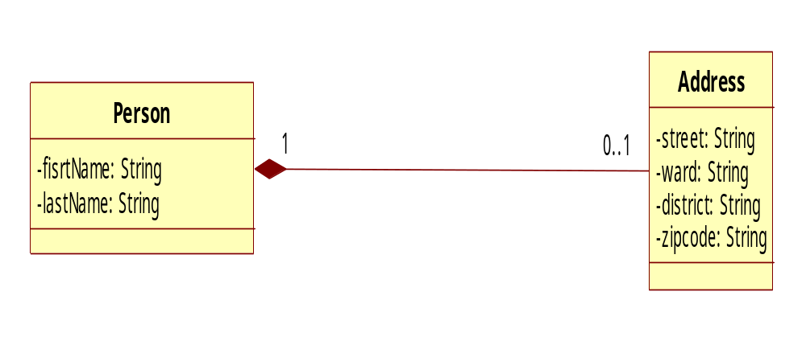
One-to-one

Slide 22
One-to-one
Hibernate mapping: Address mapping
<class name="Address" table="ADDRESS"> <id name="id" column="ADDRESS_ID"> <generator class="foreign"> <param name="property">user</param> </generator> </id> ... <one-to-one name=“person" class=“Person" constrained="true"/> </class>
constrained="true“: tells Hibernate that there is a foreign key constraint on the primary key of ADDRESS that refers to the primary key of USER.

Slide 23
One-to-one
Hibernate mapping: Person mapping
… <one-to-one name="address" class="Address" cascade="save-update"/> …
Scenario:
Address address = user.getAddress();
//Or
Person person = address.getPerson();

Slide 24
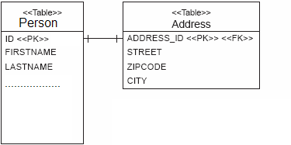
One-to-one
Table schema:

Slide 25
Exercise:

Slide 26
References
http://www.hibernate.org
http://www.roseindia.net/hibernate/index.shtml
http://www.hibernate.org/hib_docs/reference/en/html/index.html

Slide 27
Document Revision History
Date | Version | Description | Revised by
13 Sep 2011 | 1.0 | First version | To Chau
Notes:
If your document based on this template is a document that is required to control the version, you must keep this slide and fill information related to version control and fill in the fields : Owner, Reviewers, Approver, Issue date, Issue status, Document location (menu File -> Properties -> tab Custom)

